Slide 1
Beam lifetime calculation in NICA Collider
A. V. Philippov for NICA group meeting 22.10.2020

Slide 2
Outline
Problem statement
Charge exchange cross-sections
Radiative capture (beam-residual gas interaction in beam pipe)
Single Coulomb scattering
Charge exchange cross-sections
Radiative capture (beam-electron interaction in electron cooling system)
Beam lifetime
Results
Discussions

Slide 3
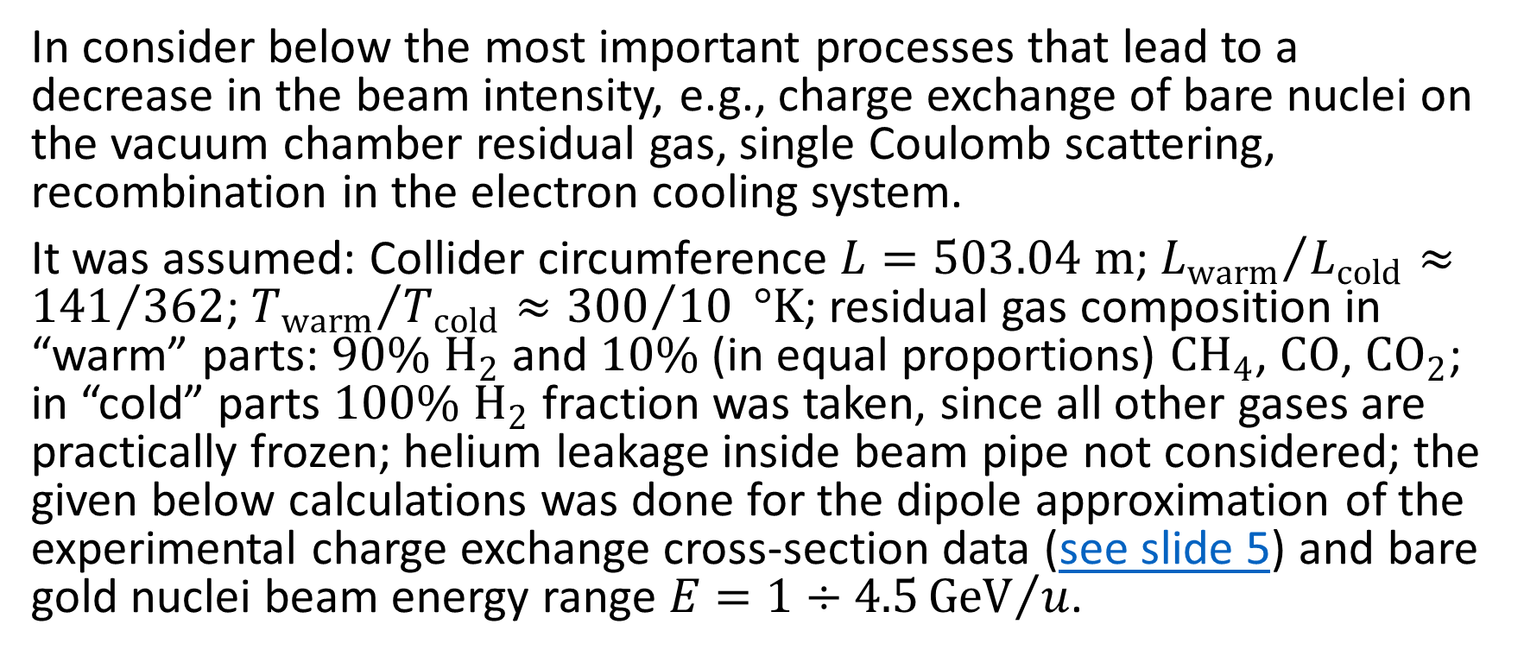
Problem statement
In consider below the most important processes that lead to a decrease in the beam intensity, e.g., charge exchange of bare nuclei on the vacuum chamber residual gas, single Coulomb scattering, recombination in the electron cooling system.
It was assumed: Collider circumference $L=503.04 m$; ${L_{warm}}/{L_{cold}}≈{141}/{362}$; ${T_{warm}}/{T_{cold}}≈{300}/{10} °K$; residual gas composition in “warm” parts: $90\% H_{2}$ and $10\%$ (in equal proportions) ${CH}_{4}$, $CO$, ${CO}_{2}$; in “cold” parts $100\% H_{2}$ fraction was taken, since all other gases are practically frozen; helium leakage inside beam pipe not considered; the given below calculations was done for the dipole approximation of the experimental charge exchange cross-section data (see slide 5) and bare gold nuclei beam energy range $E=1÷4.5{GeV}/u$.

Slide 4
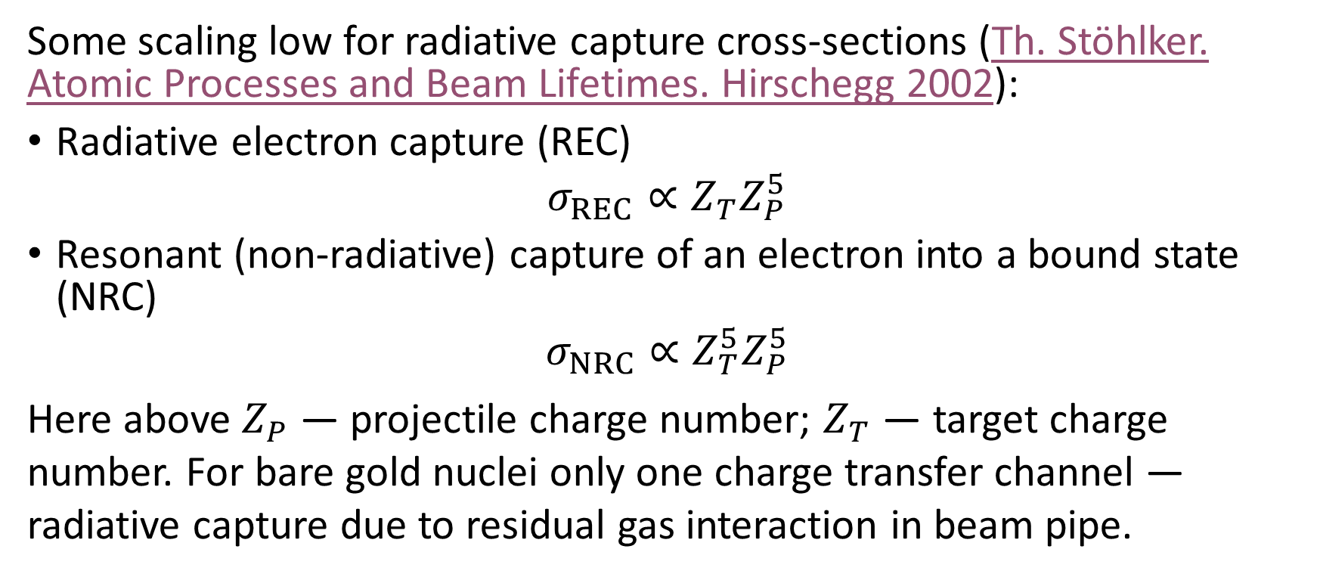
Charge exchange cross-sections Radiative capture (beam-residual gas interaction in beam pipe)
Some scaling low for radiative capture cross-sections (Th. Stöhlker. Atomic Processes and Beam Lifetimes. Hirschegg 2002):
Radiative electron capture (REC)
$$σ_{REC}∝Z_{T}Z_{P}^{5}$$
Resonant (non-radiative) capture of an electron into a bound state (NRC)
$$σ_{NRC}∝Z_{T}^{5}Z_{P}^{5}$$
Here above $Z_{P}$ — projectile charge number; $Z_{T}$ — target charge number. For bare gold nuclei only one charge transfer channel — radiative capture due to residual gas interaction in beam pipe.

Slide 5
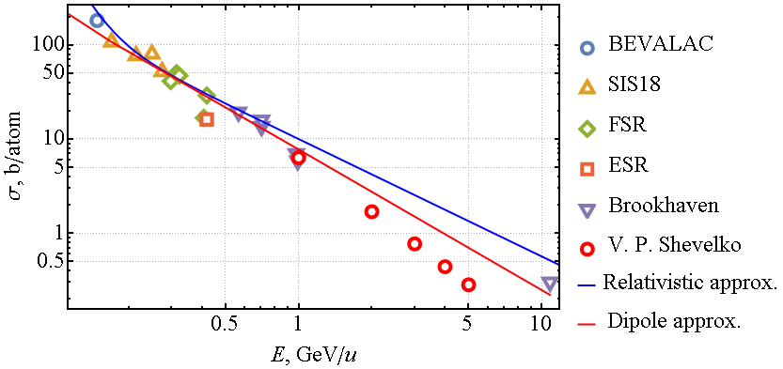
Charge exchange cross-sections Radiative capture (beam-residual gas interaction in beam pipe) (Cont.)
All data and approximation was taken from Th. Stöhlker. Atomic Processes and Beam Lifetimes. Hirschegg 2002
The V. P. Shevelko data was taken form his private communication

Slide 6
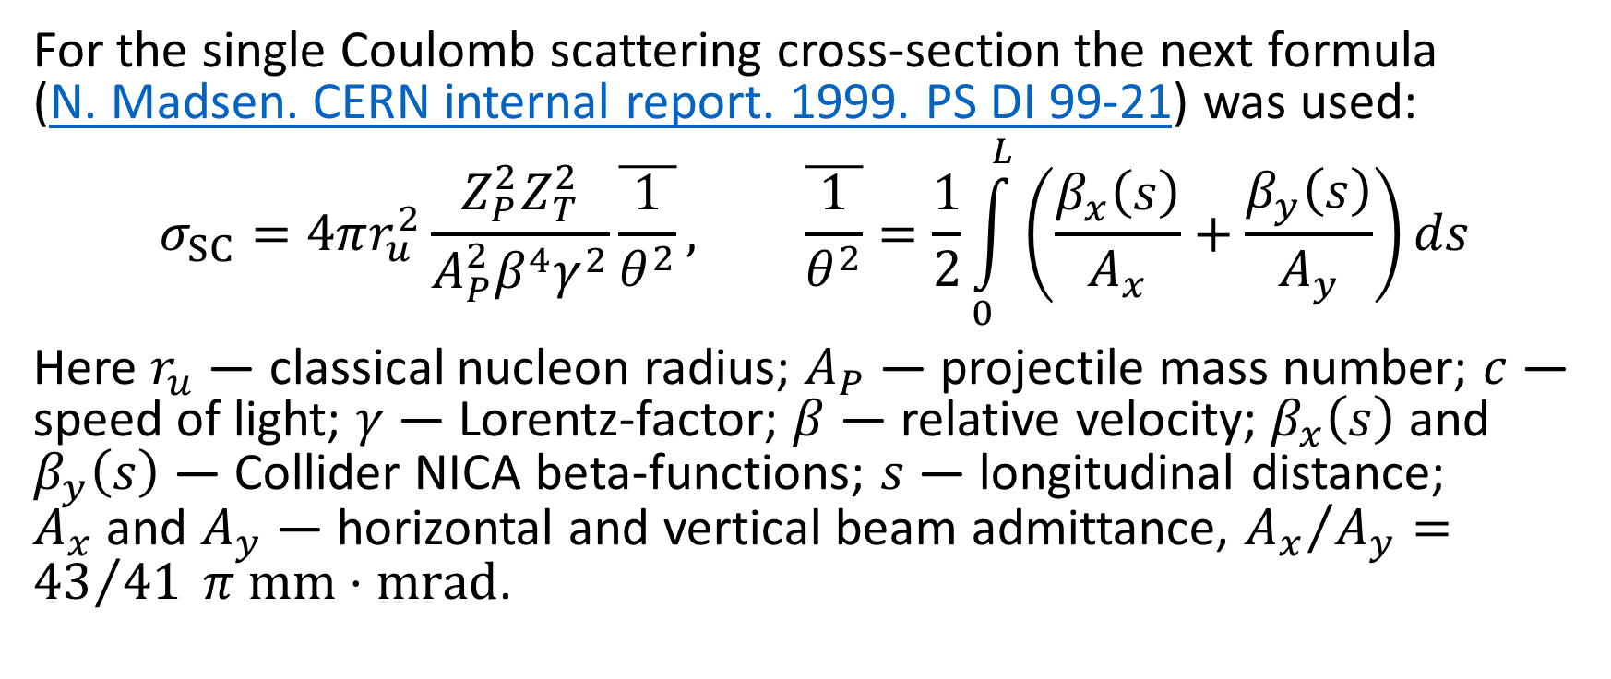
Single Coulomb scattering
For the single Coulomb scattering cross-section the next formula (N. Madsen. CERN internal report. 1999. PS DI 99-21) was used:
$$σ_{SC}=4πr_{u}^{2}\frac{Z_{P}^{2}Z_{T}^{2}}{A_{P}^{2}β^{4}γ^{2}}\overline{\frac{1}{θ^{2}}}, \overline{\frac{1}{θ^{2}}}=\frac{1}{2}\int_{0}^{L}{\left(\frac{β_{x}\left(s\right)}{A_{x}}+\frac{β_{y}\left(s\right)}{A_{y}}\right)ds}$$
Here $r_{u}$ — classical nucleon radius; $A_{P}$ — projectile mass number; $c$ — speed of light; $γ$ — Lorentz-factor; $β$ — relative velocity; $β_{x}\left(s\right)$ and $β_{y}\left(s\right)$ — Collider NICA beta-functions; $s$ — longitudinal distance; $A_{x}$ and $A_{y}$ — horizontal and vertical beam admittance, ${A_{x}}/{A_{y}}={43}/{41} π mm⋅mrad$.

Slide 7
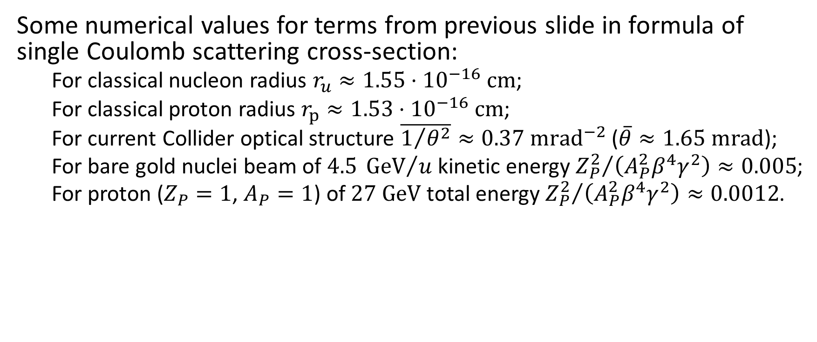
Single Coulomb scattering (Cont.)
Some numerical values for terms from previous slide in formula of single Coulomb scattering cross-section:
For classical nucleon radius $r_{u}≈1.55⋅{10}^{−16} cm$;
For classical proton radius $r_{p}≈1.53⋅{10}^{−16} cm$;
For current Collider optical structure $\overline{1/{θ^{2}}}≈0.37 {mrad}^{−2}$ ($\overline{θ}≈1.65 mrad$);
For bare gold nuclei beam of $4.5 {GeV}/u$ kinetic energy ${Z_{P}^{2}}/{\left(A_{P}^{2}β^{4}γ^{2}\right)≈0.005}$;
For proton ($Z_{P}=1$, $A_{P}=1$) of $27 GeV$ total energy ${Z_{P}^{2}}/{\left(A_{P}^{2}β^{4}γ^{2}\right)}≈0.0012$.

Slide 8
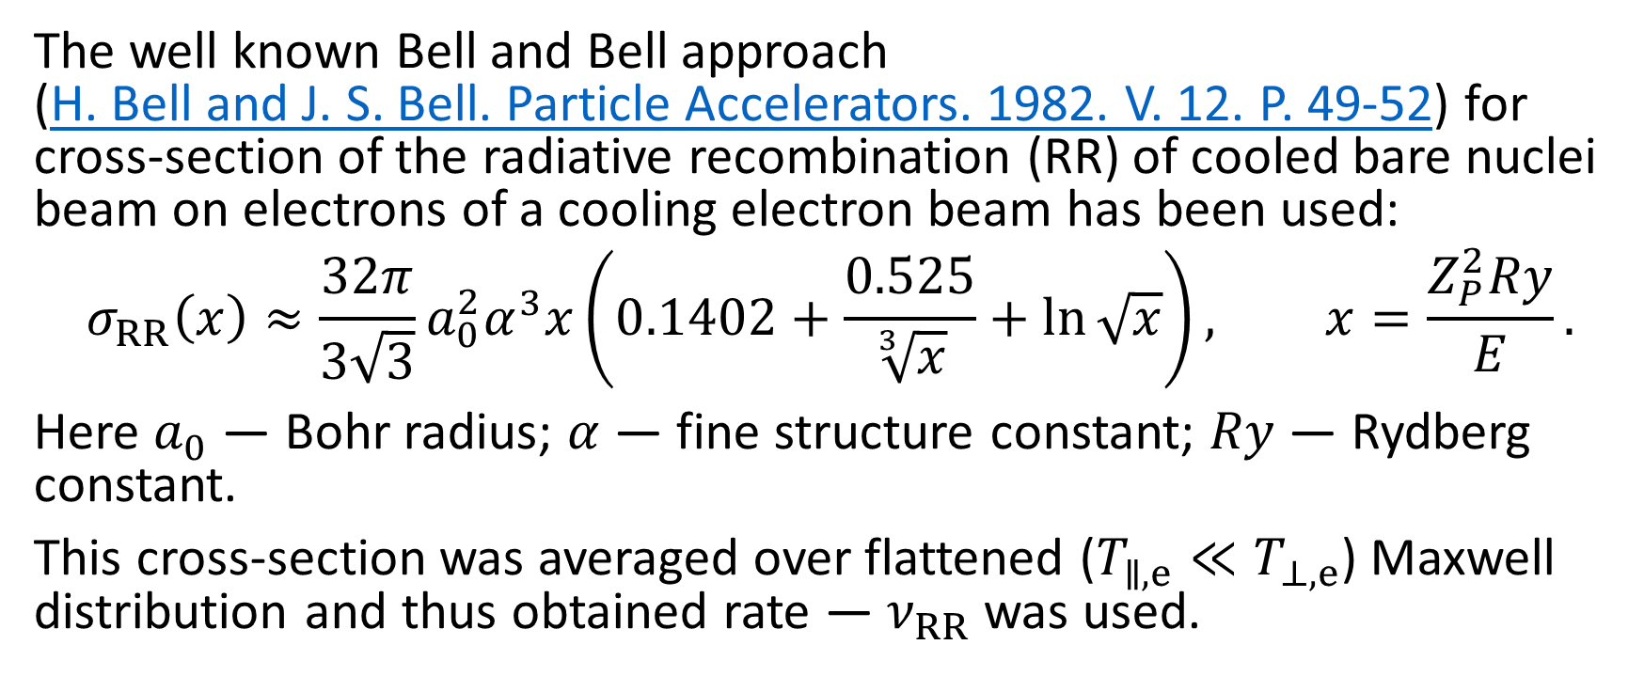
Charge exchange cross-sections Radiative capture (beam-electron interaction in electron cooling system)
The well known Bell and Bell approach (Н. Bell and J. S. Bell. Particle Accelerators. 1982. V. 12. P. 49-52) for cross-section of the radiative recombination (RR) of cooled bare nuclei beam on electrons of a cooling electron beam has been used:
$$σ_{RR}\left(x\right)≈\frac{32π}{3\sqrt{3}}a_{0}^{2}α^{3}x\left(0.1402+\frac{0.525}{\sqrt[3]{x}}+ln{\sqrt{x}}\right), x=\frac{Z_{P}^{2}Ry}{E}.$$
Here $a_{0}$ — Bohr radius; $α$ — fine structure constant; $Ry$ — Rydberg constant.
This cross-section was averaged over flattened ($T_{∥,e}≪T_{⊥,e}$) Maxwell distribution and thus obtained rate — $ν_{RR}$ was used.

Slide 9
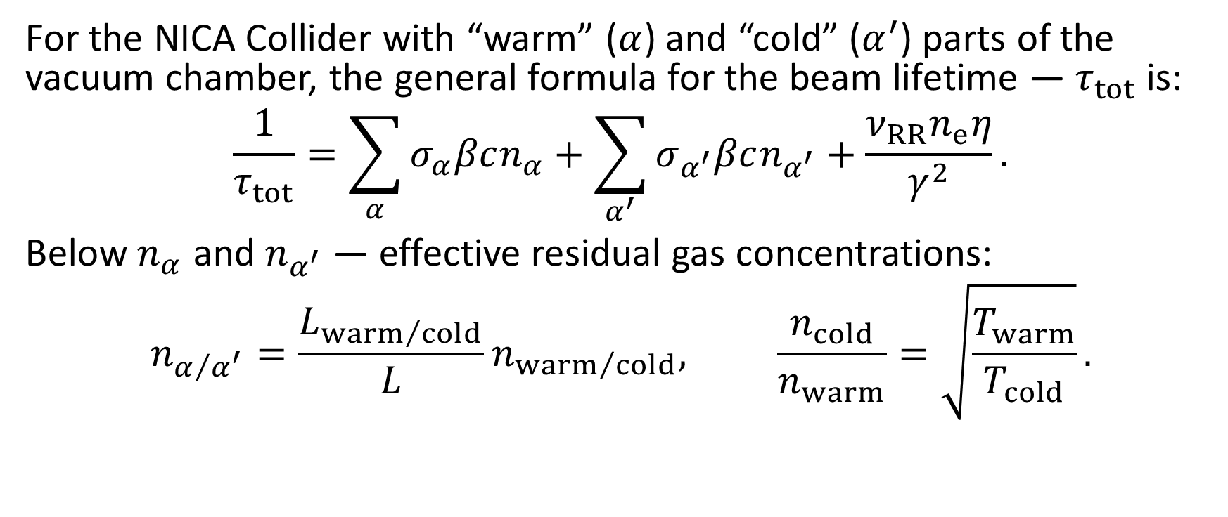
Beam lifetime
For the NICA Collider with “warm” ($α$) and “cold” ($α^{′}$) parts of the vacuum chamber, the general formula for the beam lifetime — $τ_{tot}$ is:
$$\frac{1}{τ_{tot}}=\sum_{α}{σ_{α}βcn_{α}}+\sum_{α^{′}}{σ_{α^{′}}βcn_{α^{′}}}+\frac{ν_{RR}n_{e}η}{γ^{2}}.$$
Below $n_{α}$ and $n_{α^{′}}$ — effective residual gas concentrations:
$$n_{α/{α^{′}}}=\frac{L_{{warm}/{cold}}}{L}n_{{warm}/{cold}}, \frac{n_{cold}}{n_{warm}}=\sqrt{\frac{T_{warm}}{T_{cold}}}.$$

Slide 10
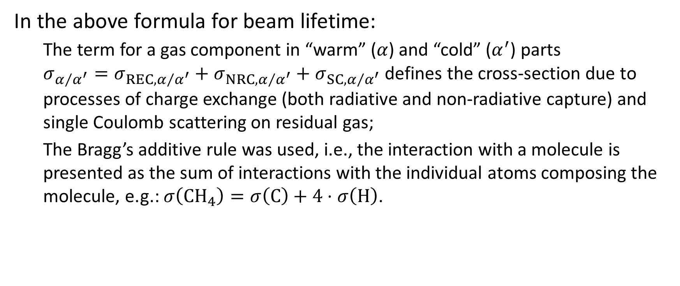
Beam lifetime (Cont.)
In the above formula for beam lifetime:
The term for a gas component in “warm” ($α$) and “cold” ($α^{′}$) parts $σ_{α/{α^{′}}}=σ_{REC,α/{α^{′}}}+σ_{NRC,α/{α^{′}}}+σ_{SC,α/{α^{′}}}$ defines the cross-section due to processes of charge exchange (both radiative and non-radiative capture) and single Coulomb scattering on residual gas;
The Bragg’s additive rule was used, i.e., the interaction with a molecule is presented as the sum of interactions with the individual atoms composing the molecule, e.g.: $σ\left({CH}_{4}\right)=σ\left(C\right)+4⋅σ\left(H\right)$.

Slide 11
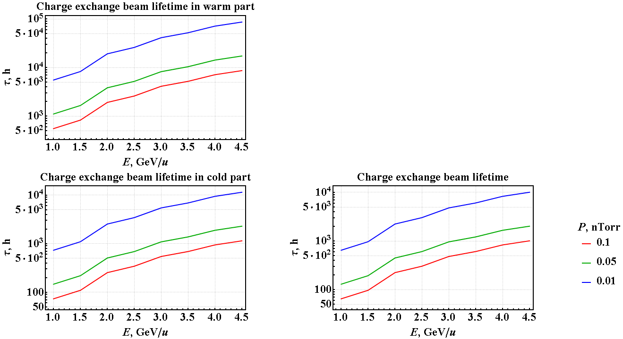

Results
Charge exchange cross-sections Radiative capture (beam-residual gas) Dipole approximation (see slide 5) Pressure ($P$) is given in “warm” parts

Slide 12
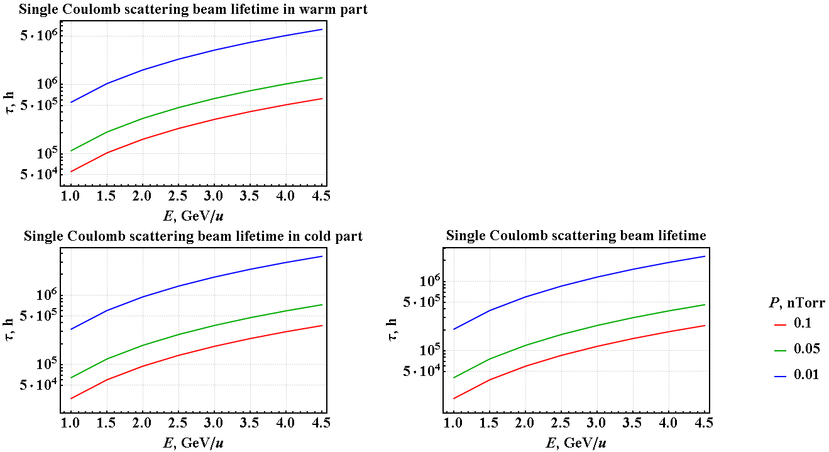
Results (Cont.)
Single Coulomb scattering Analytic formula (see slide 6)

Slide 13
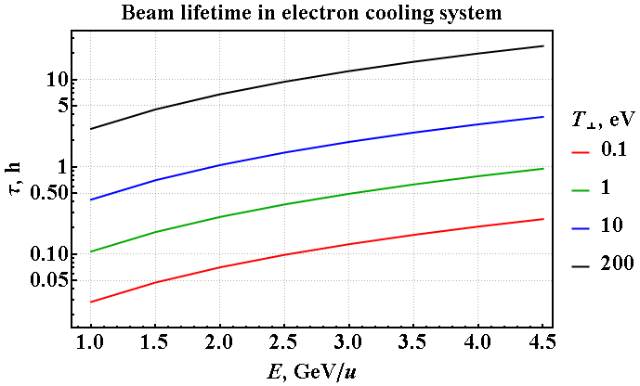
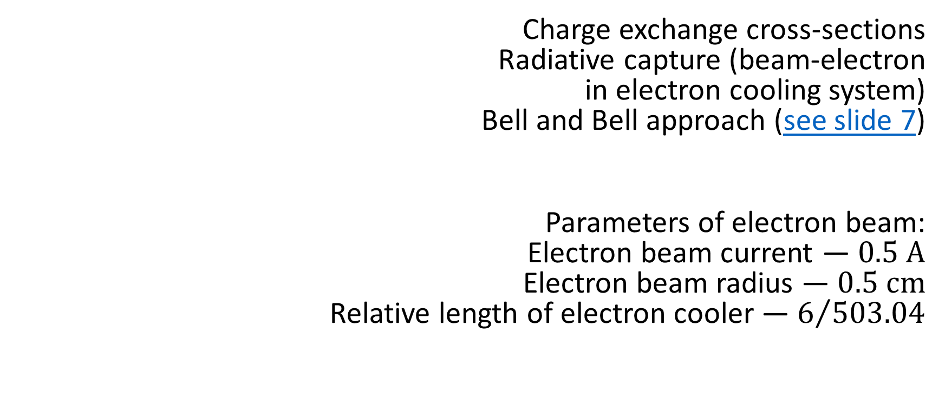
Results (Cont.)
Charge exchange cross-sections Radiative capture (beam-electron in electron cooling system) Bell and Bell approach (see slide 7)
Parameters of electron beam: Electron beam current — $0.5 A$ Electron beam radius — $0.5 cm$ Relative length of electron cooler — $6/{503.04}$

Slide 14
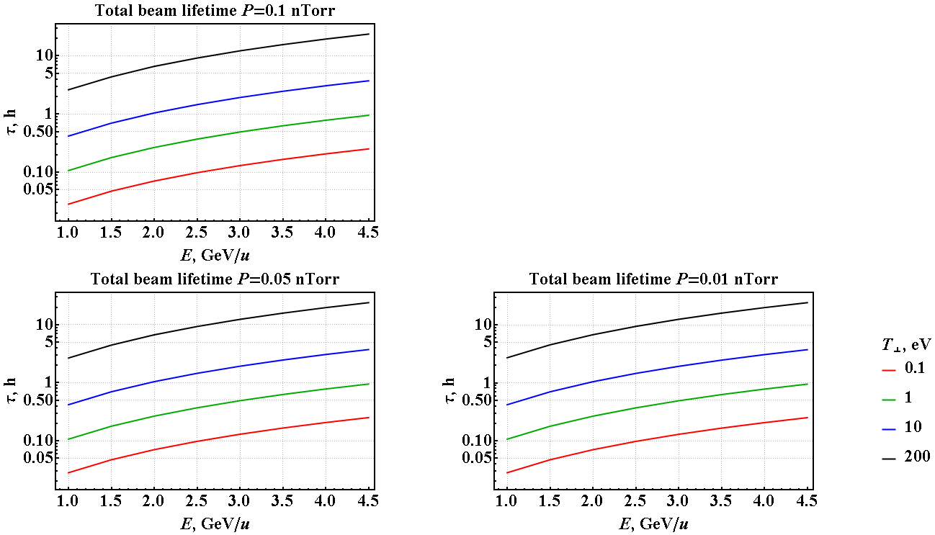
Results (Cont.)
Total beam lifetime for different pressure and temperature of electron beam
The other electron beam parameters are the same like on previous slide

Slide 15
Discussions
The total beam lifetime due to all the processes considered in this calculations mainly is determined by ions radiative recombination on cooling electrons in the electron cooler system (when it’s turned on).
In this case the beam lifetime can be enchantment of the cooling electron temperature.
The shown results for the total beam lifetime have weak dependence on the residual gas pressure distribution along the Collider ring circumference.
When the electron cooler is off the choice of approximation model (see slide 5) weakly affects, in range of half order, on beam lifetime calculation results.

